Slide 1






AlphaGo Zero
Report by Lin Shen
2017.11.16
Notes:
Good evening, everyone. Today I would like to share with you something about AlphaGo Zero.

Slide 2


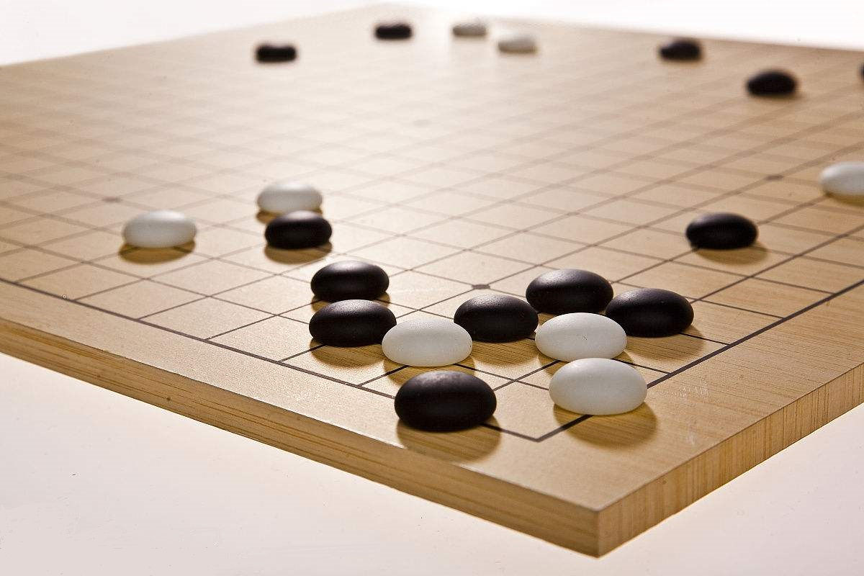
AlphaGo Zero
The strongest Go program
AlphaGo Zero is a version of DeepMind's Go software AlphaGo.
AlphaGo's team published an article in the journal Nature on 19 October 2017
It outperformed all previous versions of AlphaGo.
Notes:
AlphaGo Zero is a version of DeepMind's Go software AlphaGo. AlphaGo's team published an article in the journal Nature on 19 October 2017, introducing AlphaGo Zero, a version created without using data from human games, and stronger than any previous version.^{[1]}
///////////////////从零学习
AlphaGo Zero's unsupervised learning technology revolution does not apply to all areas of artificial intelligence. Go is a game of chess, it has a clear structure, and can be described by the rules.
Beyond the game, AlphaGo Zero's technology could be used in other areas, such as new material development and protein folding, but it also takes time to verify.
[ˈverɪfaɪ] Moreover, in the fields of speech recognition, image recognition, natural speech understanding, and driverless [d'raɪvərles], the data can’t be exhaustive [ɪgˈzɔ:stɪv] and can hardly be completely absent .AlphaGo Zero's technology can reduce the data requirements, but still requires a lot of data.
So I don’t think all AI can start from scratch.

Slide 3

01
Training
The unsupervised learning of AlphaGo Zero

Slide 4
Training
AlphaGo Zero's neural network was trained using TensorFlow
64 GPU workers
19 CPU parameter servers
four TPUs were used for inference
The neural network initially knew nothing about Go beyond the rules.
The AI engaged in "unsupervised learning"
Notes:
AlphaGo Zero's neural network was trained using TensorFlow, which is an open-source software library for dataflow programming across a range of tasks. with 64 GPU workers and 19 CPU parameter servers. Only four TPUs were used for inference.
The neural network initially knew nothing about Go beyond the rules. The AI engaged in "unsupervised learning", playing against itself until it could anticipate its own moves and how those moves would affect the game's outcome
注：A tensor processing unit (TPU) is an application-specific integrated [ˈɪntɪgreɪtɪd] circuit [ˈsɜ:kɪt] (ASIC) developed by Google specifically for machine learning.
//////////////////////////技术
AlphaGo Zero’ main techniques, the first one is Monte ['mɒntɪ] Carlo Tree Search, which does not exhaustive all combinations, to find the best or second best location. The second one is ResNet technology invented by Dr. Sun Jian. ResNet introduces the residual [rɪˈzɪdjuəl] network, which enables simple search algorithms to greatly improve efficiency. And the third one is Reinforcement Learning, during the process of Reinforcement Learning data can be collected independently. So AlphaGo Zero doesn’t use any human data, instead, what it has to do is to learn for itself completely from self-play.

Slide 5
Training
It is able to do this by using a novel form of reinforcement learning, in which AlphaGo Zero becomes its own teacher. The system starts off with a neural network that knows nothing about the game of Go. It then plays games against itself, by combining this neural network with a powerful search algorithm.
As it plays, the neural network is tuned and updated to predict moves, as well as the eventual winner of the games. This updated neural network is then recombined with the search algorithm to create a new version of AlphaGo Zero, and the process begins again.
Notes:
It is able to do this by using a novel form of reinforcement learning, in which AlphaGo Zero becomes its own teacher. The system starts off with a neural network that knows nothing about the game of Go. It then plays games against itself, by combining this neural network with a powerful search algorithm. As it plays, the neural network is tuned [tju:n] and updated to predict moves, as well as the eventual winner of the games.
This updated neural network is then recombined with the search algorithm to create [kriˈeɪt] a new, stronger version of AlphaGo Zero, and the process begins again. In each iteration, the performance of the system improves by a small amount, and the quality of the self-play games increases, leading to more and more accurate neural networks and ever stronger versions of AlphaGo Zero.

Slide 6
02
Comparison with predecessors
Machine learning ->data or algorithm?
Notes:
[ˈpri:dɪsesə(r)]

Slide 7

Comparison with predecessors
All previous versions of AlphaGo initially trained on thousands of human amateur and professional games to learn how to play Go
AlphaGo Zero skips this step and learns to play simply by playing games against itself
Notes:
All previous versions of AlphaGo initially trained on thousands of human amateur and professional games to learn how to play Go, they were told in this position, the human expert played this particular move, and in this other position the human expert played here. AlphaGo Zero doesn’t use any human data, instead, what it has to do is to learn for itself completely from self-play.
// Does the result of AlphaGo Zero mean that data is no longer important?
AlphaGo Zero的结果是否意味着数据不再重要？
In AlphaGo Zero, algorithms matter much more than either compute or data availability.
This is because Go is a game of chess, it has a clear structure, and can be described by the rules.
However, many other problems in the field of machine learning, such as image recognition, speech recognition, machine translation [trænsˈleɪʃn], are not described by simple rules.
So in my opinion, the success of AlphaGo Zero does not mean data is no longer important.
//AlphaGo Zero为什么可以摒弃人类的棋谱？(不需要数据)
AlphaGo Zero uses Reinforcement Learning, during the process of Reinforcement Learning data can be collected independently. So AlphaGo Zero doesn’t use any human data, instead, what it has to do is to learn for itself completely from self-play.

Slide 8
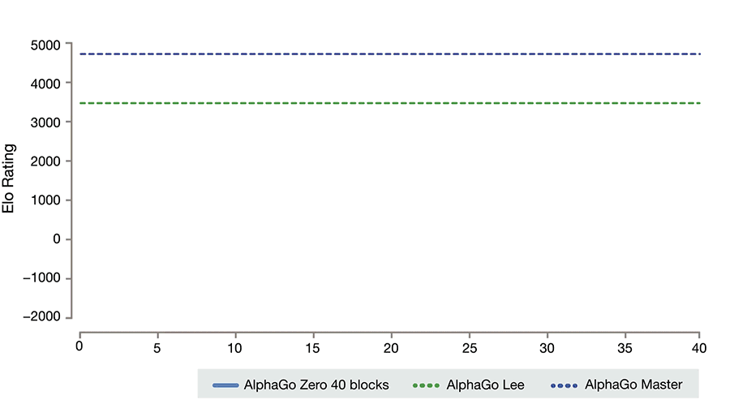
Comparison with predecessors
Notes:
AlphaGo Zero has no prior knowledge of the game and only the basic rules as an input.
By playing games against itself,
AlphaGo Zero surpassed the strength of AlphaGo Lee in three days by winning 100 games to 0, the version that beat world champion Lee Sedol in 4 out of 5 games in 2016.
reached the level of AlphaGo Master in 21 days, the version that defeated 60 top professionals online and world champion Ke Jie in 3out of 3 games in 2017.
and exceeded all the old versions in 40 days, arguably, becomes the best Go players in the world. It does this entirely from self-play, with no human intervention and using no historical data.

Slide 9
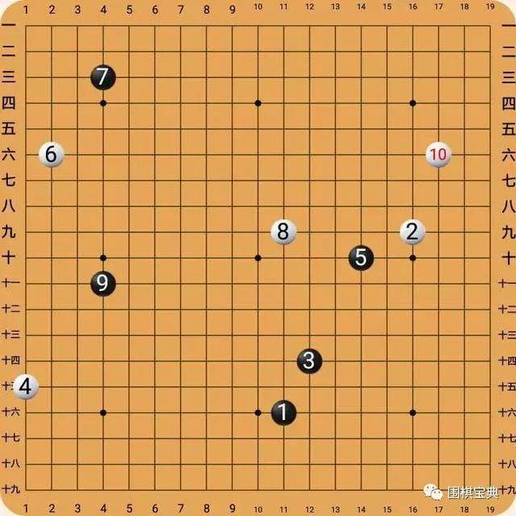
Comparison with predecessors
First of all, AlphaGo always has an opponent at just the right level. And yet every step the learning process, it has an opponent, that’s exactly calibrated to its current level of performance.
This technique is more powerful than previous versions of AlphaGo because it is able to learn tabula rasa from the strongest player in the world: AlphaGo itself.
Notes:
So the reason that playing against itself enabled it to do better than using strong human data is that first of all, AlphaGo always has an opponent at just the right level, so it starts off extremely naïve, it starts off completely random play. And yet every step the learning process, it has an opponent, or sparring partner if you like, that’s exactly calibrated to its current level of performance. To begin with, these players are very weak, but over time, they become progressively stronger and stronger.
This technique [tekˈni:k] is more powerful than previous versions of AlphaGo because it is no longer constrained by the limits of human knowledge. Instead, it is able to learn tabula rasa from the strongest player in the world: AlphaGo itself.

Slide 10
Comparison with predecessors
It also differs from previous versions in other notable ways.
AlphaGo Zero only uses the basic rules as its input
It uses one neural network rather than two, allowing it to be trained and evaluated more efficiently.
It relies on its high quality neural networks to evaluate positions.
Notes:
It also differs from previous versions in other notable ways.
AlphaGo Zero only uses the black and white stones from the Go board as its input, whereas previous versions of AlphaGo included a small number of hand-engineered features.
It uses one neural network rather than two. Earlier versions of AlphaGo used a “policy network” to select the next move to play and a ”value network” to predict the winner of the game from each position. These are combined in AlphaGo Zero, allowing it to be trained and evaluated more efficiently.
AlphaGo Zero does not use “rollouts” - fast, random games used by other Go programs to predict which player will win from the current board position. Instead, it relies on its high quality neural networks to evaluate positions.
All of these differences help improve the performance of the system and make it more general. But it is the algorithmic change that makes the system much more powerful and efficient.
//Why AlphaGo Zero much faster than AlphaGo?
为什么AlphaGo Zero 会比 AlphaGo 快很多？
It is the algorithmic change that makes AlphaGo Zero much more powerful and efficient.
Earlier versions of AlphaGo used a “policy network” to select the next move to play and a ” value network” to predict the winner of the game from each position. These are combined in AlphaGo Zero, allowing it to be trained and evaluated more efficiently.

Slide 11
03
Application

Slide 12


Application
Starting from scratch
machine learning
People tend to assume that machine learning is all about big data and massive amounts of computation. But actually we saw in AlphaGo Zero is that algorithms matter much more than either compute or data availability.
big data
random behavior
unsupervised learning
tabula rasa
This is all for a system that has been trained completely from scratch starting from random behavior and progressing from first principles to really discover tabula rasa how to play the game of Go
Notes:
People tend to assume that machine learning is all about big data and massive amounts of computation. But actually we saw in AlphaGo Zero is that algorithms matter much more than either compute or data availability. In AlphaGo Zero, we use more than an order of magnitudes [‘mæɡnɪtju:dz] 巨大 less computation than we used in previous versions of AlphaGo. And yet it was able to performed much higher level due to using much more principled algorithms than we had before.
This is all for a system that has been trained completely from scratch , starting from random behavior and progressing from first principles , to really discover tabula rasa [ˌtæbjʊlə ˈrɑ:zə] how to play the game of Go
///////////////////////////////意义
AlphaGo Zero was widely regarded as a significant advance, even when compared with its predecessor [ˈpri:dɪsesə(r)], AlphaGo. It is a "major breakthrough for artificial intelligence".
As we know, Artificial [ˌɑ:tɪˈfɪʃl] intelligence research has made rapid progress in a wide variety of domains from speech recognition to drug discovery. In many cases, these are specialist systems that need enormous amounts of human expertise [ˌekspɜ:ˈti:z] and data.
However, for some problems this human knowledge may be too expensive, too unreliable or simply unavailable. As a result, a long-standing ambition of AI research is to bypass this step, creating algorithms that achieve superhuman performance in the most challenging domains with no human input. AlphaGo Zero means we make a significant step towards this goal.

Slide 13

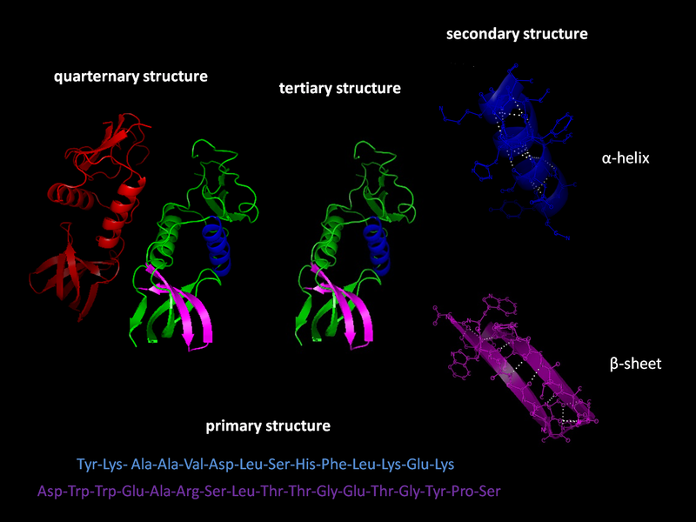
Application
Discovering new knowledge
AI will be a multiplier for human ingenuity, helping us with our mission to solve some of the most important challenges humanity is facing. While it is still early days, AlphaGo Zero constitutes a critical step towards this goal.
protein folding
reducing energy consumption
searching for revolutionary new materials
The resulting breakthroughs have the potential to positively impact society.
Notes:
Over the course of millions of AlphaGo vs [ˈvɜ:səs] AlphaGo games, the system progressively learned the game from scratch, accumulating thousands of years of human knowledge during a period of just a few days. AlphaGo Zero also discovered new knowledge, developing unconventional strategies ['strætədʒi] and creative new moves that echoed [ˈekəʊ] and surpassed the novel techniques it played in the games against Lee Sedol and Ke Jie.
These moments of creativity give us confidence that AI will be a multiplier [ˈmʌltɪplaɪə(r)] for human ingenuity, [ˌɪndʒəˈnju:əti] helping us with our mission to solve some of the most important challenges [ˈtʃæləndʒ] humanity [hju:ˈmænəti] is facing.
While it is still early days, AlphaGo Zero constitutes ['kɒnstɪtju:ts] a critical step towards this goal. If similar techniques can be applied to other structured problems, such as protein folding [ˈprəʊti:n] [ˈfəʊldɪŋ] , reducing energy consumption or searching for revolutionary new materials, the resulting breakthroughs have the potential to positively [ˈpɒzətɪvli] impact society.
//////////////////////////////////////应用
AlphaGo's algorithms are likely to be of the most benefit to domains [dəˈmeɪn] that requires an intelligent search through an enormous space of possibilities, such as protein folding or accurately simulating ['sɪmjʊleɪtɪŋ] chemical reactions.^{[10]} AlphaGo's techniques are probably less useful in domains that are difficult to simulate, such as learning how to drive a car
///////////////////////////////////未来
AlphaGo Zero is able to discover new knowledge, develop unconventional strategies and creative [kriˈeɪtɪv] new moves. So I think AI will be a multiplier for human ingenuity[ˌɪndʒəˈnju:əti], helping us with our mission to solve some of the most important challenges humanity is facing.

Slide 14
THANK YOU
Notes:
That's all for my presentation. Thank you for listening.
// Will artificial intelligence threaten humans?威胁
AlphaGo Zero proves that artificial intelligence is developing rapidly, and also shows us that there are areas where we can make a major breakthrough without human knowledge, human data and human guidance.
However, AlphaGo Zero can only be used in a single, simple domain, and it is less capable
[ˈkeɪpəbl] of thinking independently, setting goals, creating ideas, and self-awareness. Even smart as AlphaGo Zero, it just do digital optimization [ˌɒptɪmaɪ'zeɪʃən] after humans giving the goal.
As far as I’m concerned, artificial intelligence will not threaten humans.
//Does AlphaGo Zero mean the Go problem can be solve by the computer with an ultimate solution?
AlphaGo Zero是不是意味着围棋问题算是被计算机解决了，有一个终极的解，是这样吗？
Yes, I agree.
//What’s the impact on Go? 对围棋的影响
Chinese Go professional, Ke Jie commented [ˈkɒment] on the remarkable accomplishments [əˈkʌmplɪʃmənt] of the new program via his Weibo account, "A pure self-learning AlphaGo is the strongest, humans seem redundant [rɪˈdʌndənt] in front of its self-improvement."
I think the Go world are now being influenced by AlphaGo’s playing style, creating new ideas from them, and AlphaGo's development will have an impact on Go players.
I do not know much about this issue either. Maybe we can check it on the internet later.

